Slide 1


INTERNATIONAL SCHOOL OF INFORMATICS AND MANAGEMENT
TECHNICAL CAMPUS,JAIPUR
Affiliated By Rajasthan Technical University Kota, Rajasthan-324010
PRESENTED BY:-
MASTER OF COMPUTER APPLICATIONS SEM – 3rd
NIKHIL KUMAWAT
MCA/2020/4287
Industrial Project Report
Project Name: Real Estate House Price Predictor
Submitted To:
Faculty Mentor
Dr. Vijay Gupta

Slide 2
TRAINING AT Techienest Pvt. Ltd, Jaipur
DURATION: 3 MONTHS
FROM : 30 March – 14june
INTERNS ARE :
NIKHIL KUMAWAT – MCA/2020/4287

Slide 3

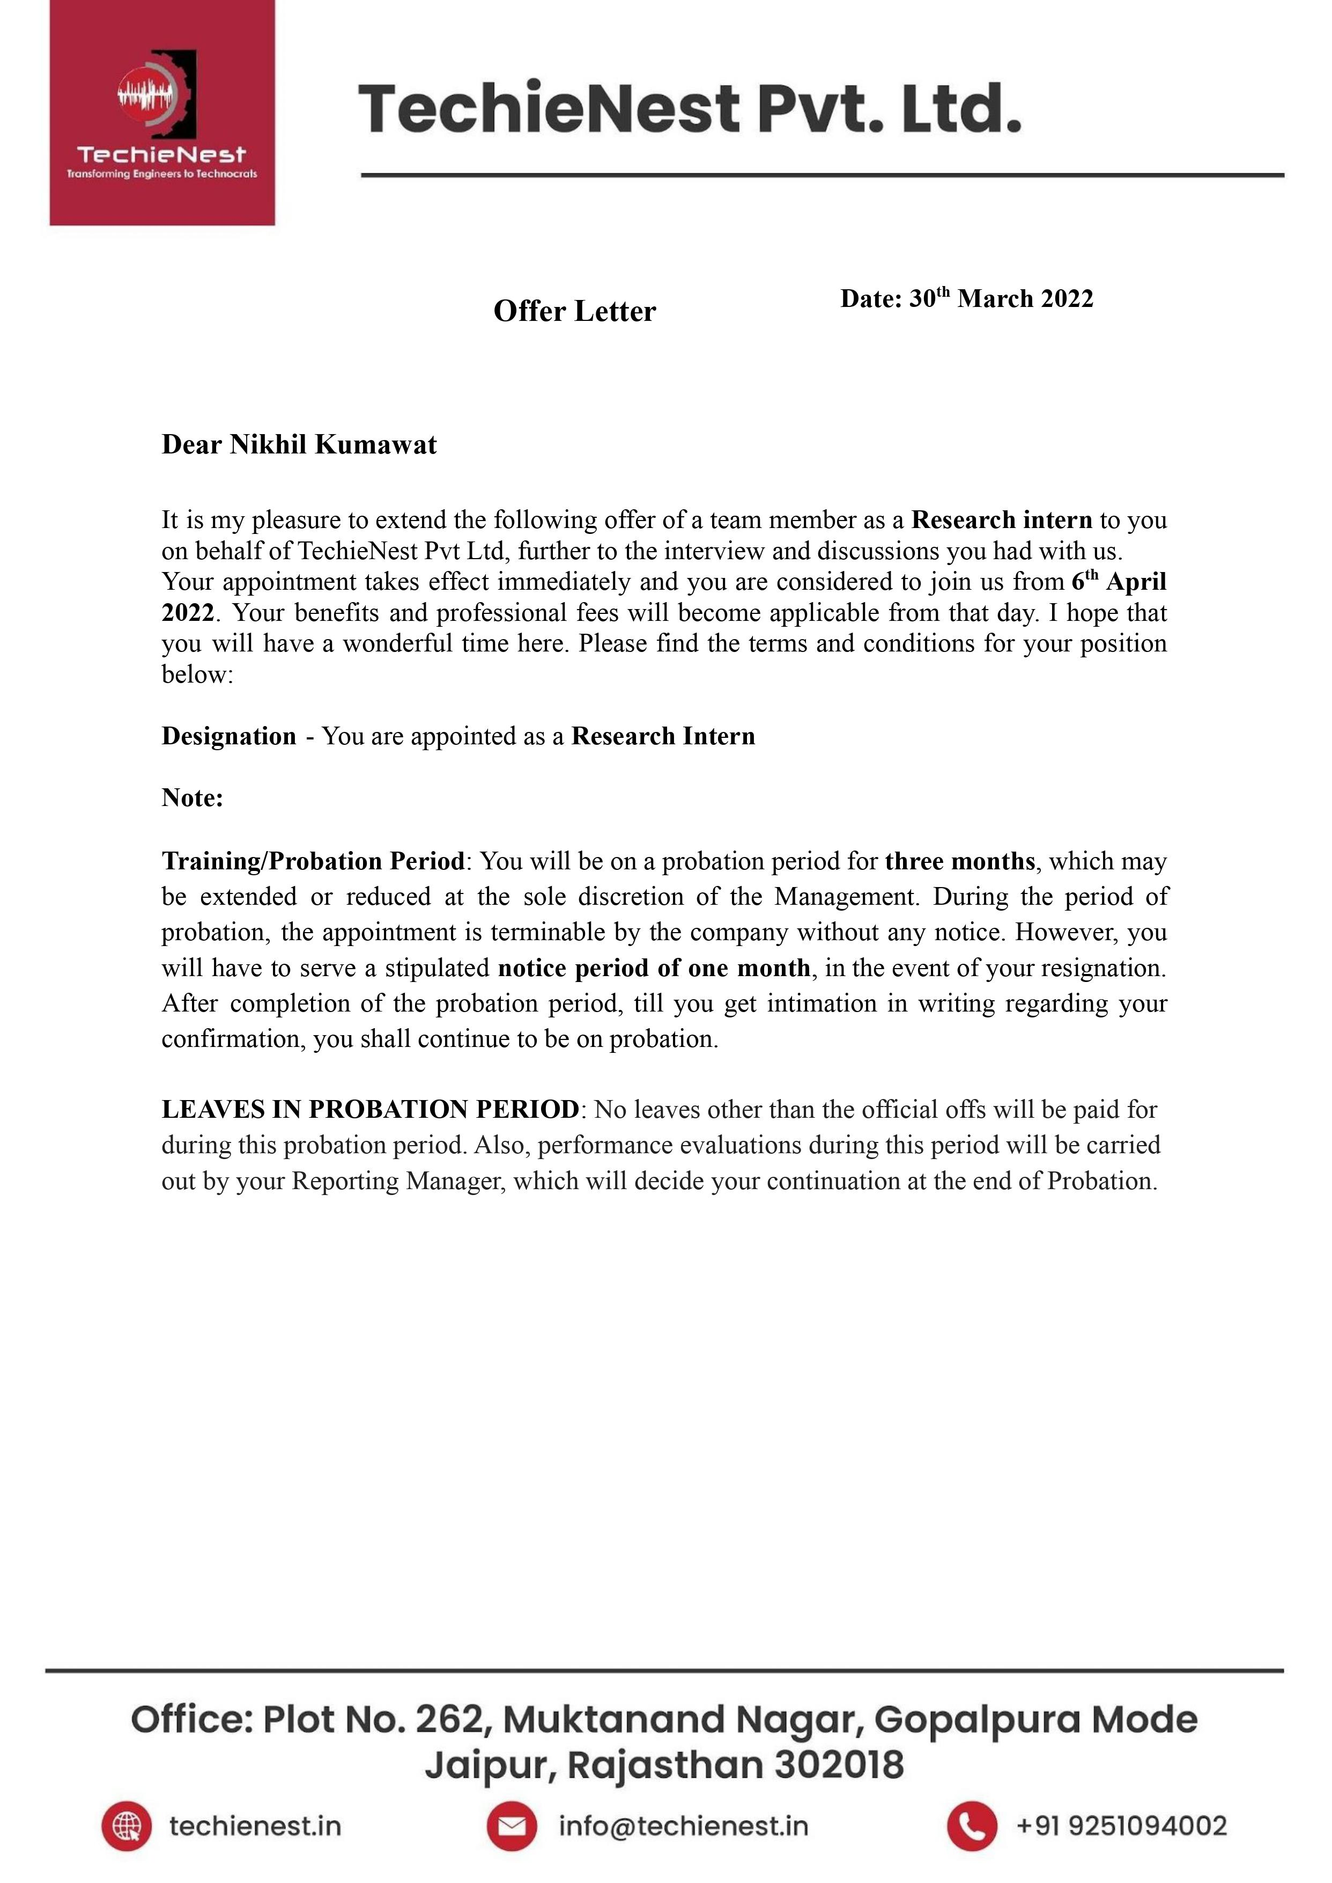
NIKHIL KUMAWAT

Slide 4
COMPANY PROFILE
NAME OF THE COMPANY : Techienest Pvt. Ltd, jaipur
WEBSITE : https://techienest.in/
INDSUTRY : EDUCATIOAN
Location: 262, Opposite Pooja Tower, Muktanand Nagar, Gopal Pura Mode, Jaipur, Rajasthan 302018
TYPE OF COMPANY : Public , Online education
FOUNDED : 2008
SPEACIALIZATION : TechieNest is a certified ISO 9001:2008, technology service provider and training organization. The soul mission of founders is to facilitate the education, research and development program; all under one roof.

Slide 5
Company Overview
TechieNest is a certified ISO 9001:2008, technology service provider and training organization. The soul mission of founders is to facilitate the education, research and development program; all under one roof. In a very short span of time our team has successfully delivered the impactful service to more than 350 colleges, including the most prestigious institutions of India, such as IIT Mumbai, IIT Delhi and all the NITs. All over the India, with our 6 centers, we are renowned for our own manufacturing unit and unique content. TechieNest is moving ahead with an ideology where practical and theory are equally emphasized. In the vast growing ‘Technical Era’ we are rising with a mission to expand the set boundaries of the ‘techie-brains’ to Explore, Invent and Innovate!

Slide 6
Prerequisite
In this machine learning project we using python and how machine learning problems are tackled in real world scenarios. We will understand the problem of a real estate company then apply ML to solve it.
In this project we will be walking you through analyzing the problem from collecting data, importing it to a Jupyter notebook, looking for promising attributes, finding out correlations, plotting graphs, creating a pipeline, dealing with missing values and much more. In this project we have used ML models Like Linear Regression, Decision Tree, Random Forest like models to understand how this model will work on Real world Data.
At the end we present the problem to the real estates company who will use the model for predicting house prices given a set of features. Here we have focused on how concepts like cross validation, train-test splitting, stratified shuffle split, cross validation and sampling work in action.

Slide 7
Problem TearDown :-
We are giving dataset of house prices with some features like no. of bathrooms, no. of bedrooms etc.
Our Task is to create a model which will predict the price for any new house by looking at the features
While learning about Machine Learning it is best to actually work with real-world data. Not just artificial datasets.
There are hundreds of open datasets to choose from. We have already work with already talked about the same in this ML course

Slide 8
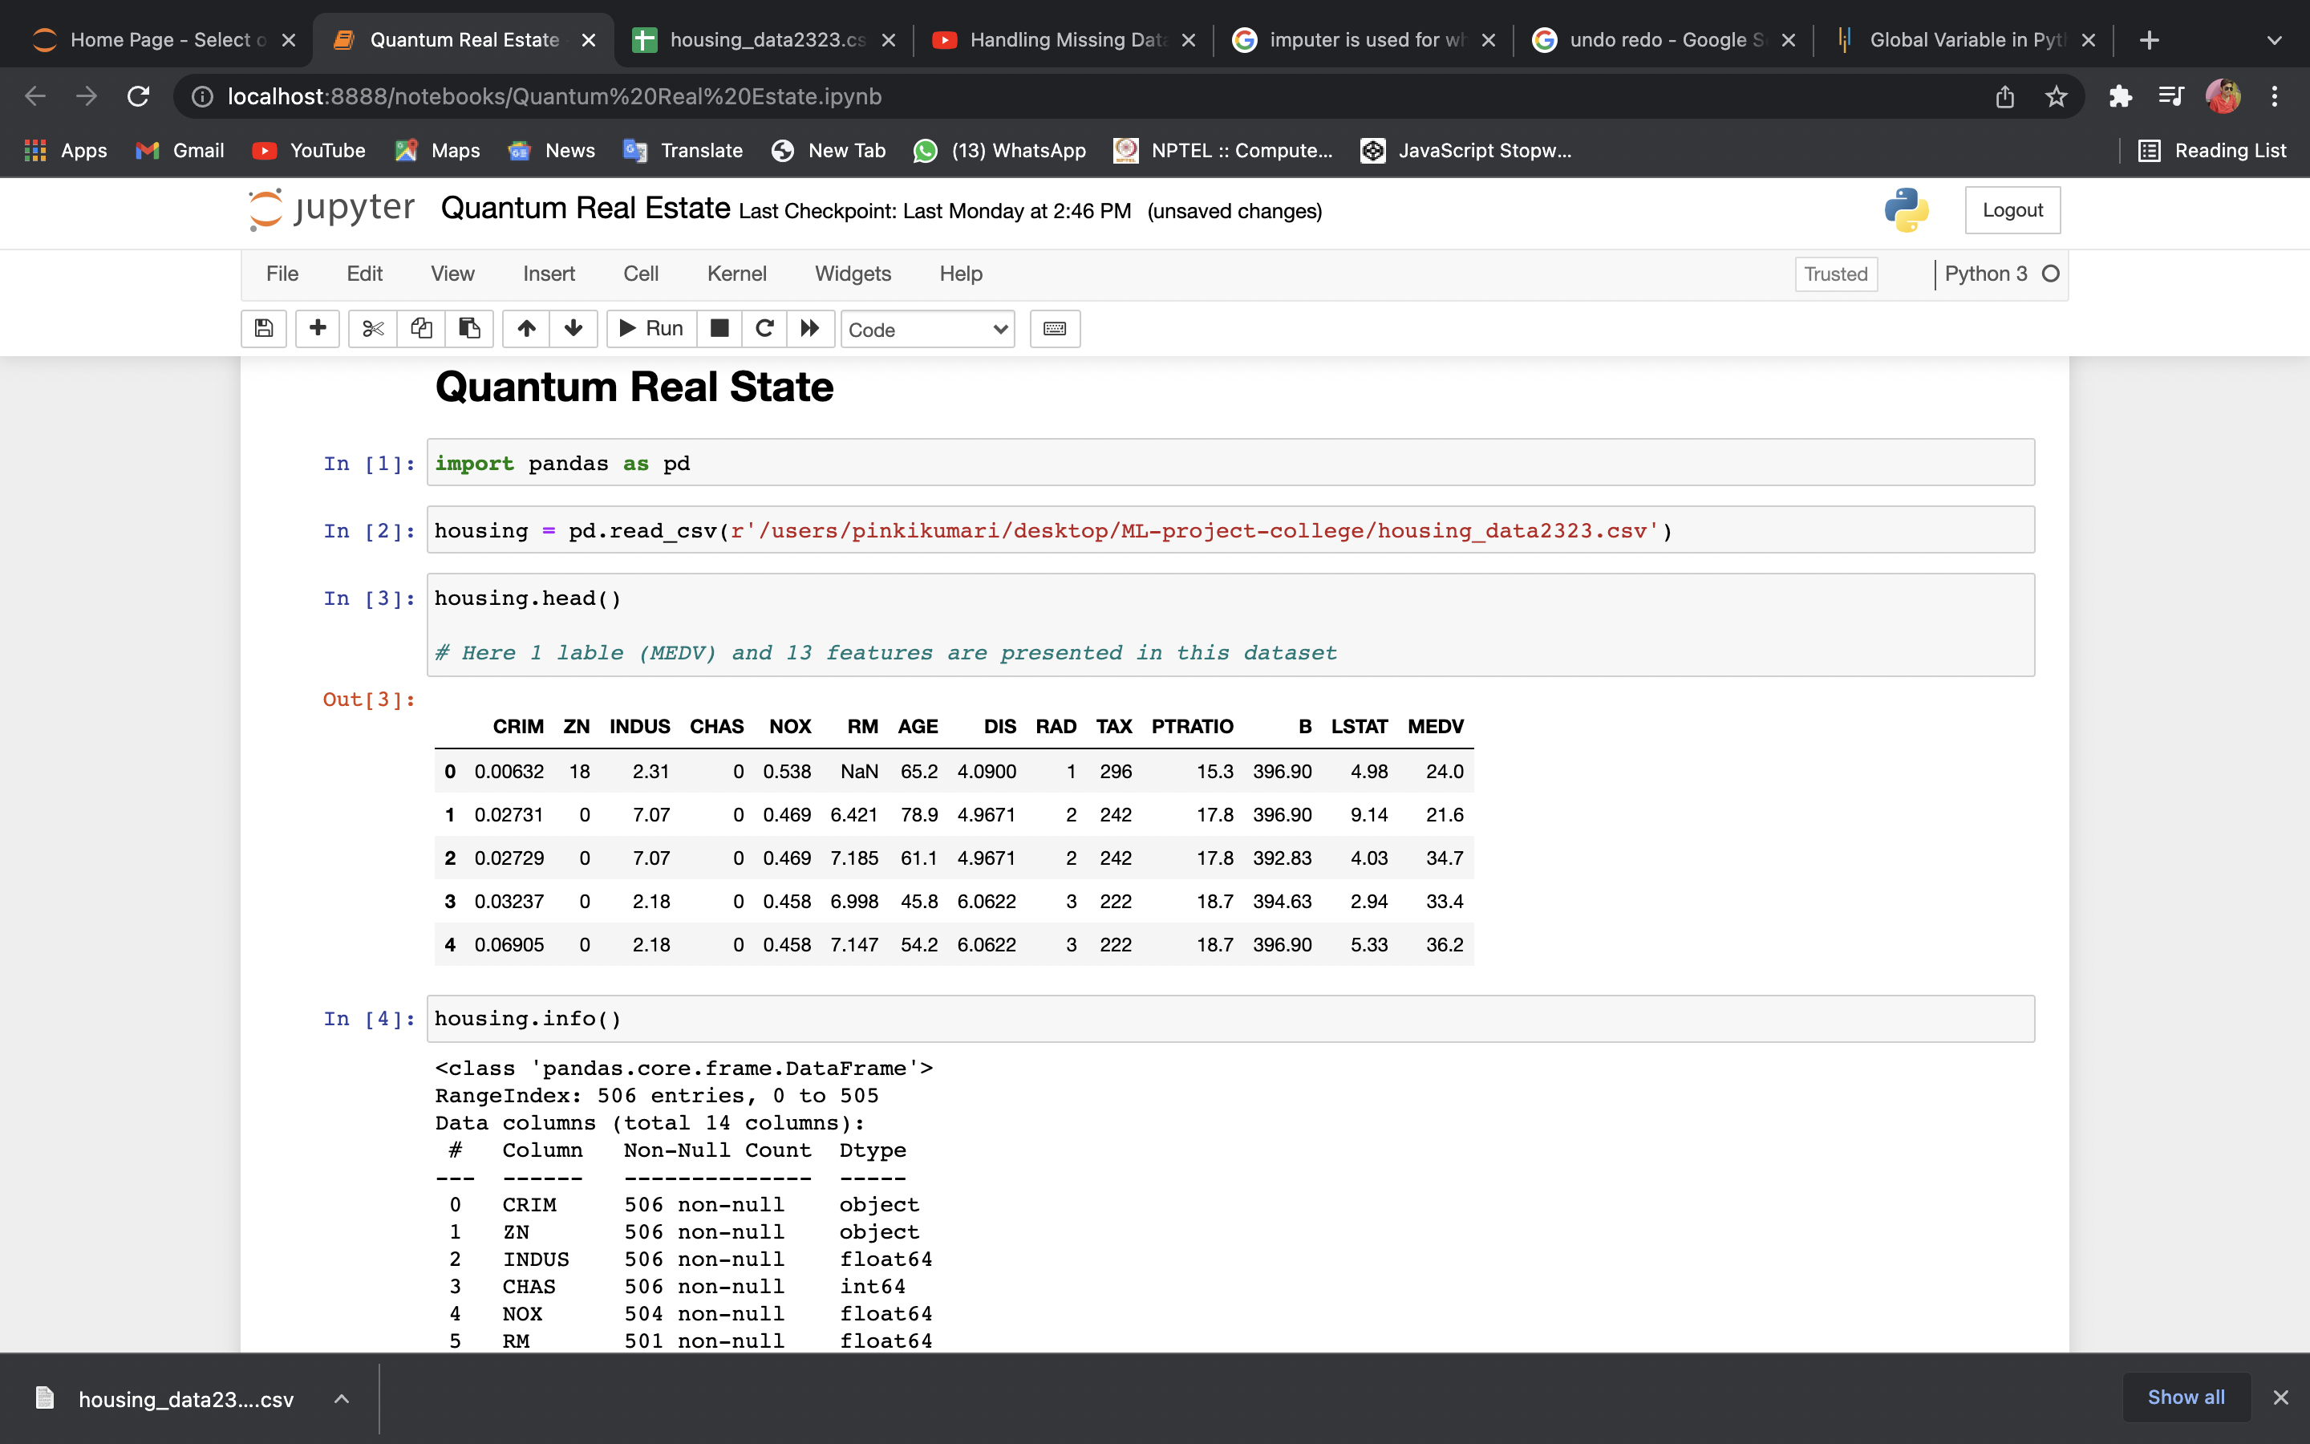
REAL ESTATE PREDICTION CODE

Slide 9
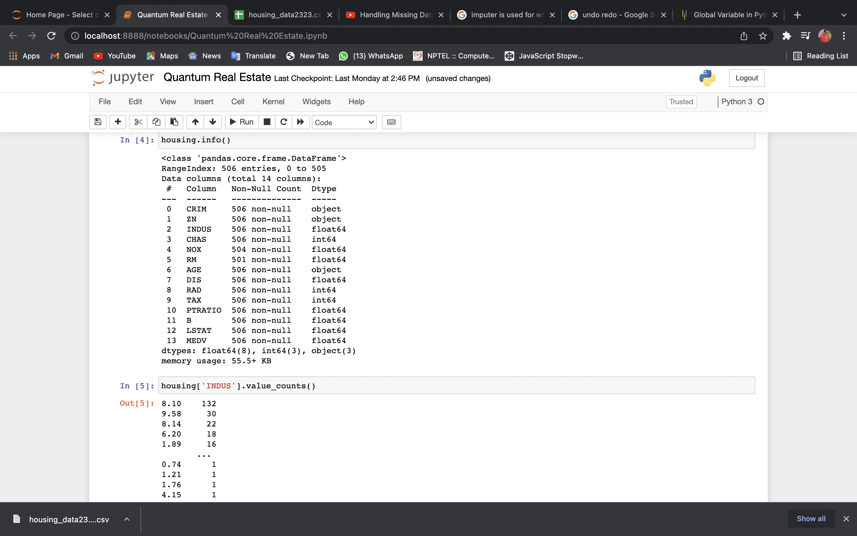
11

Slide 10
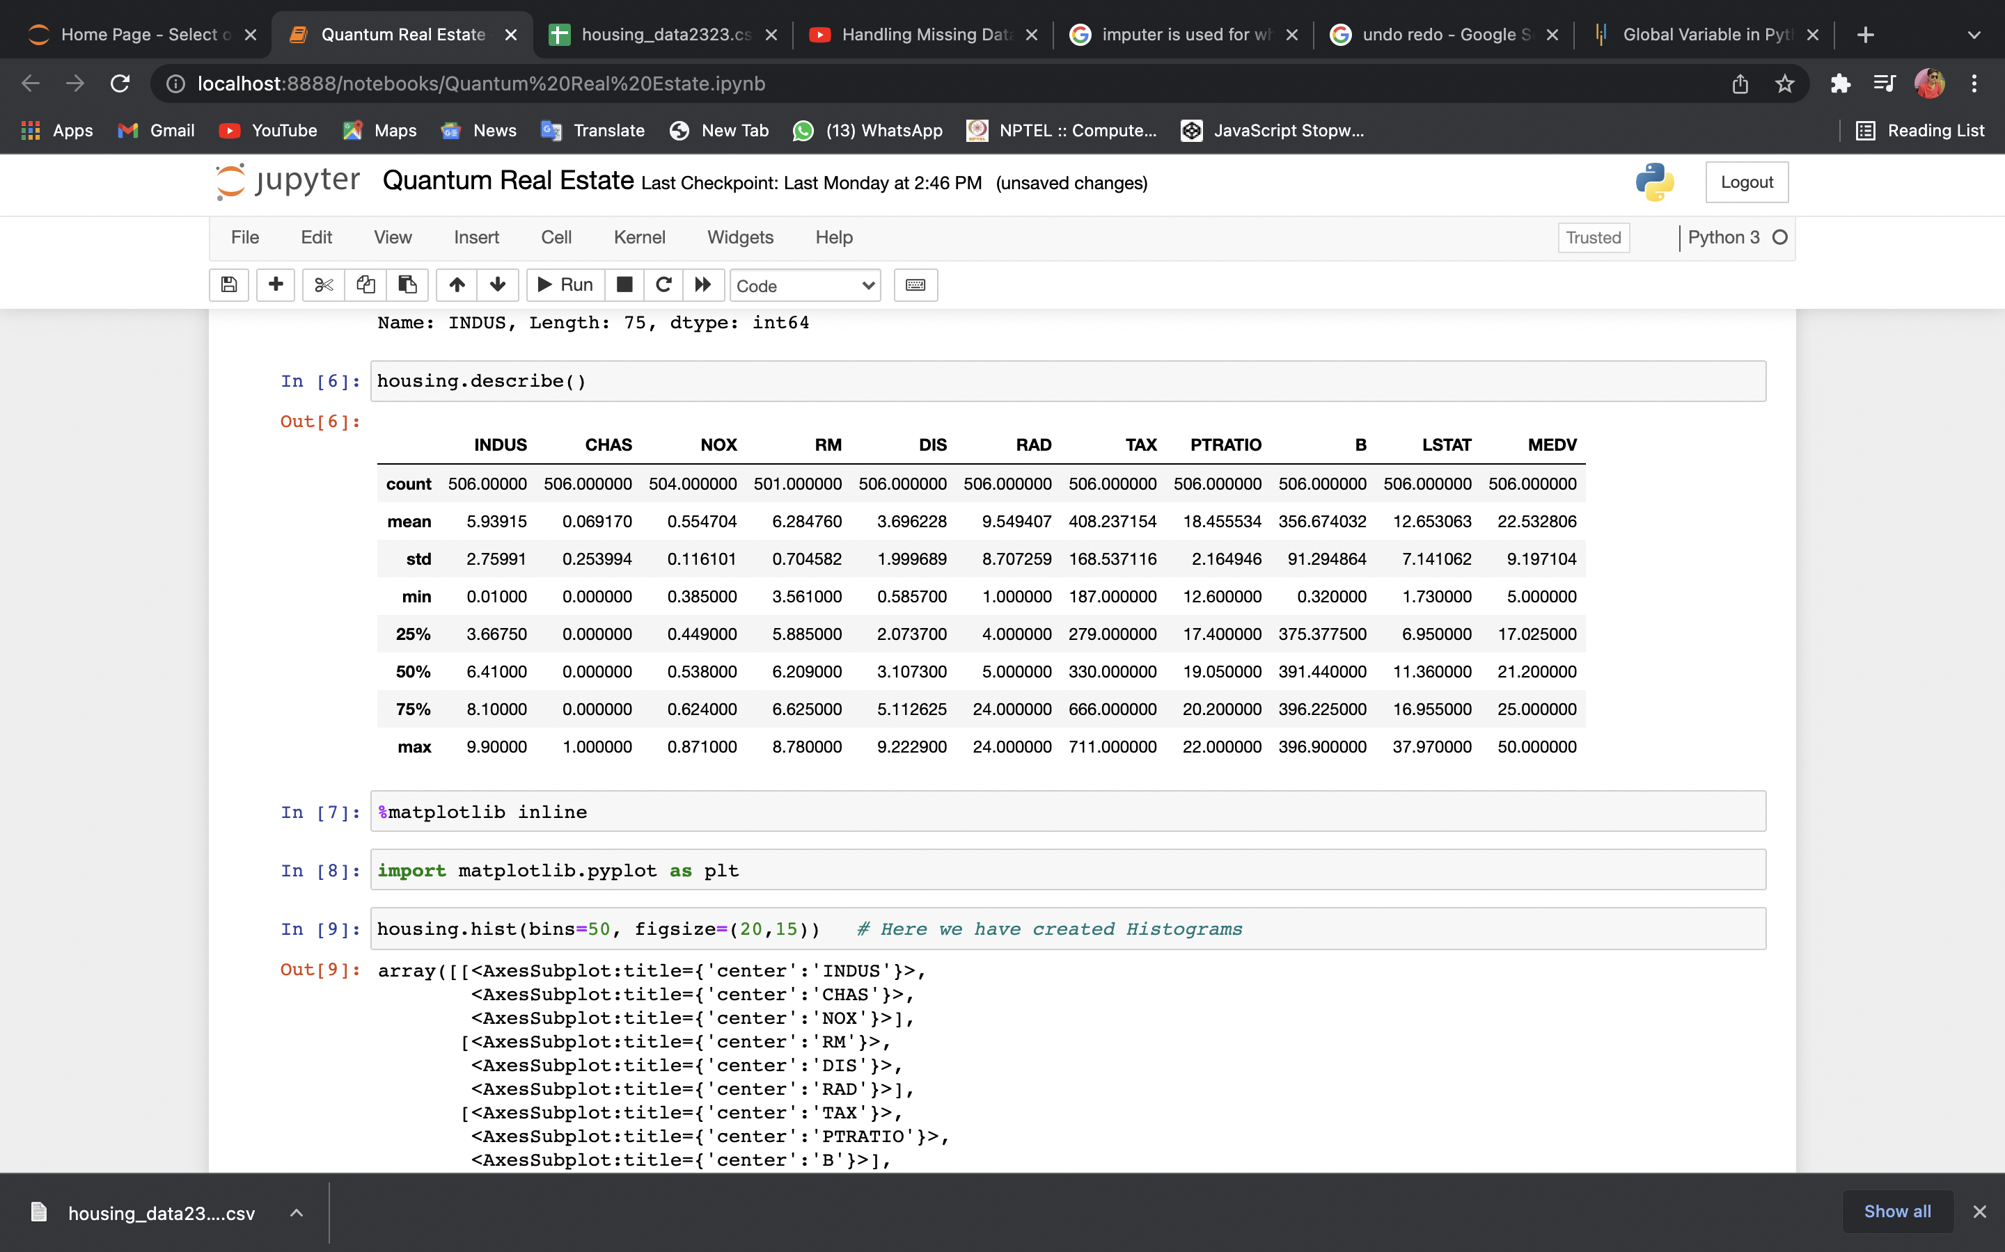
89,526,124$
100%

Slide 11
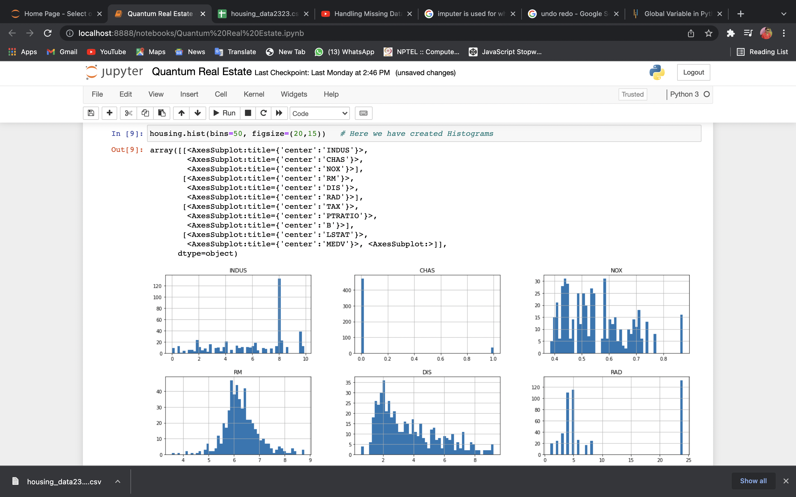

Slide 12
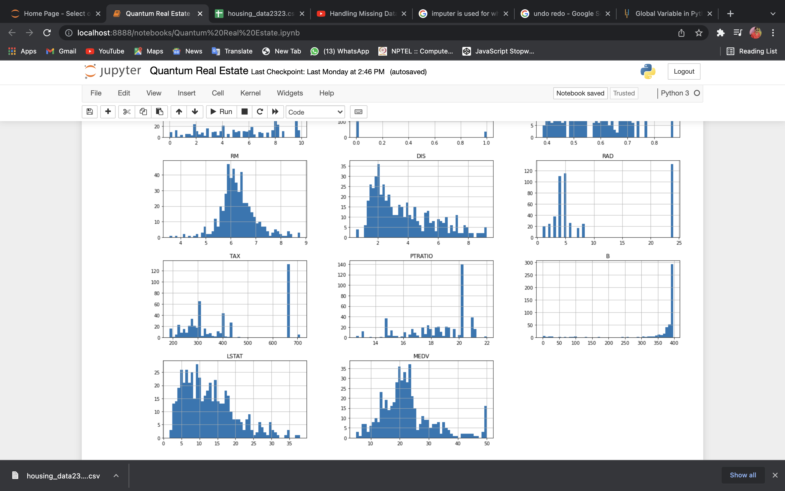

Slide 13
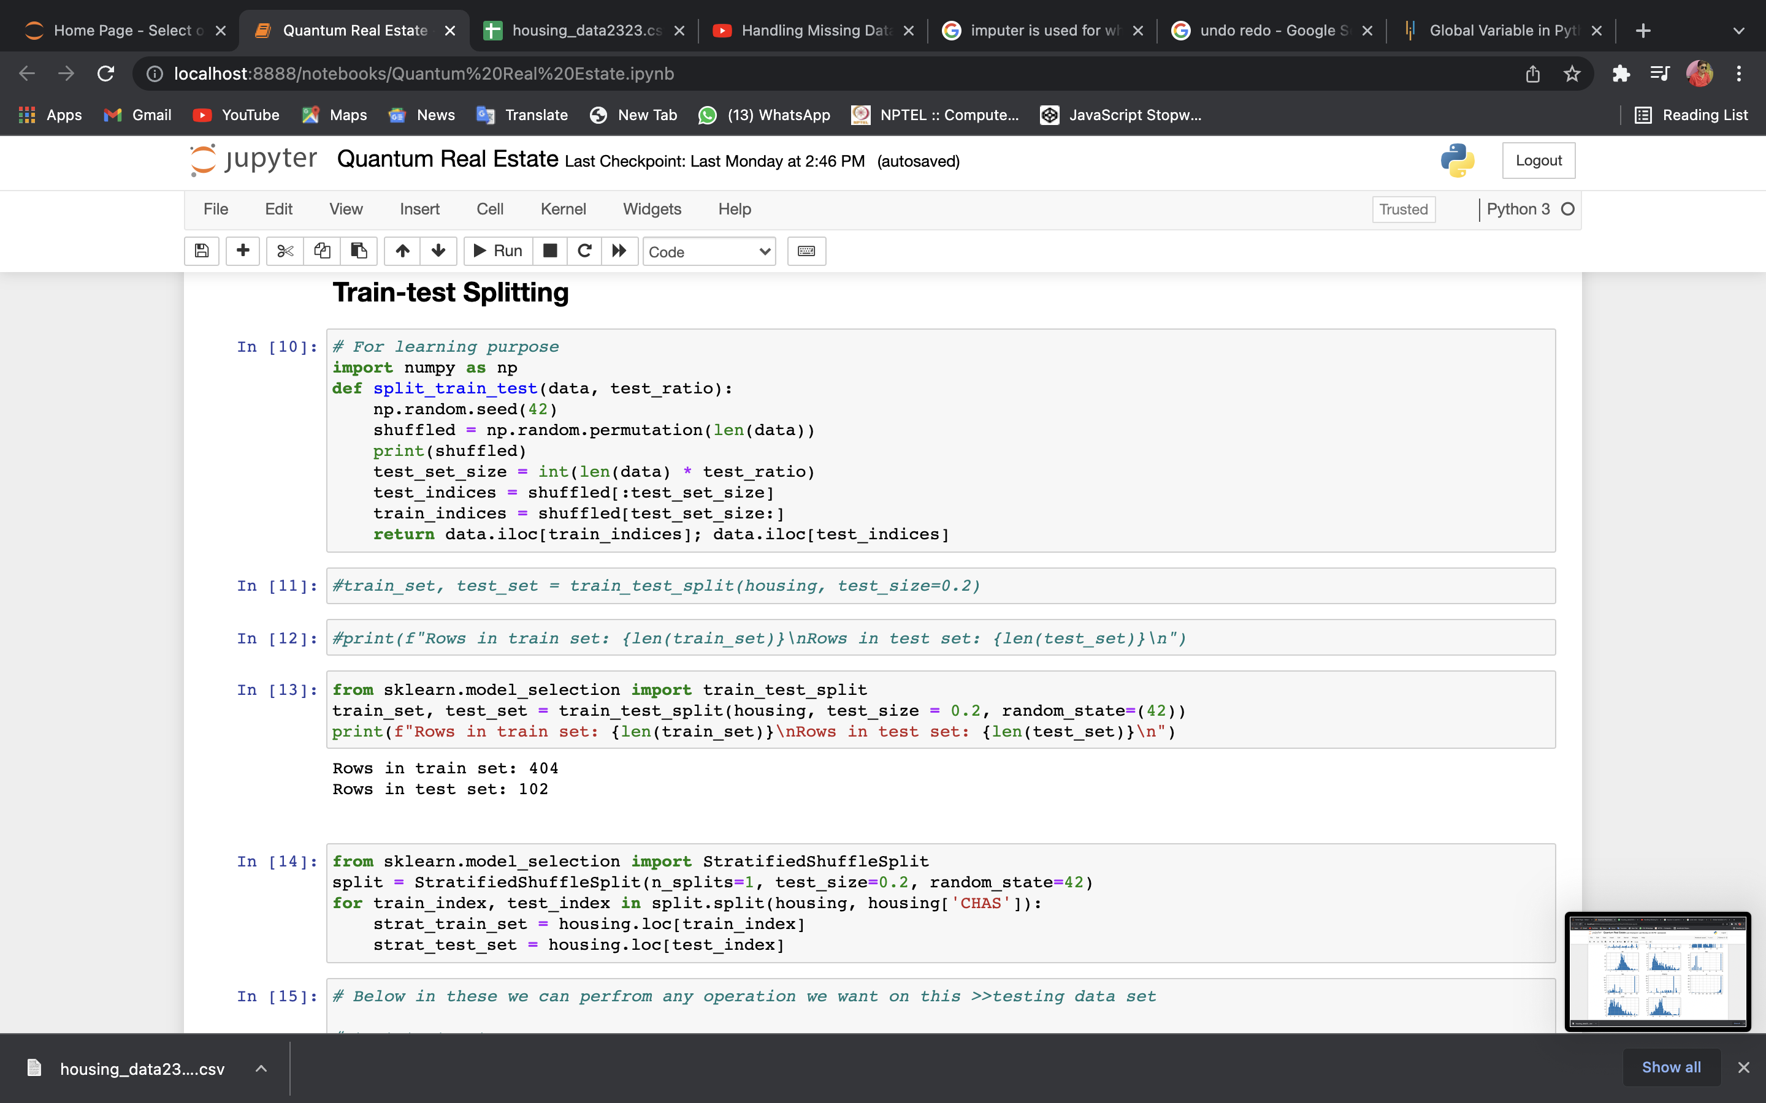

Slide 14
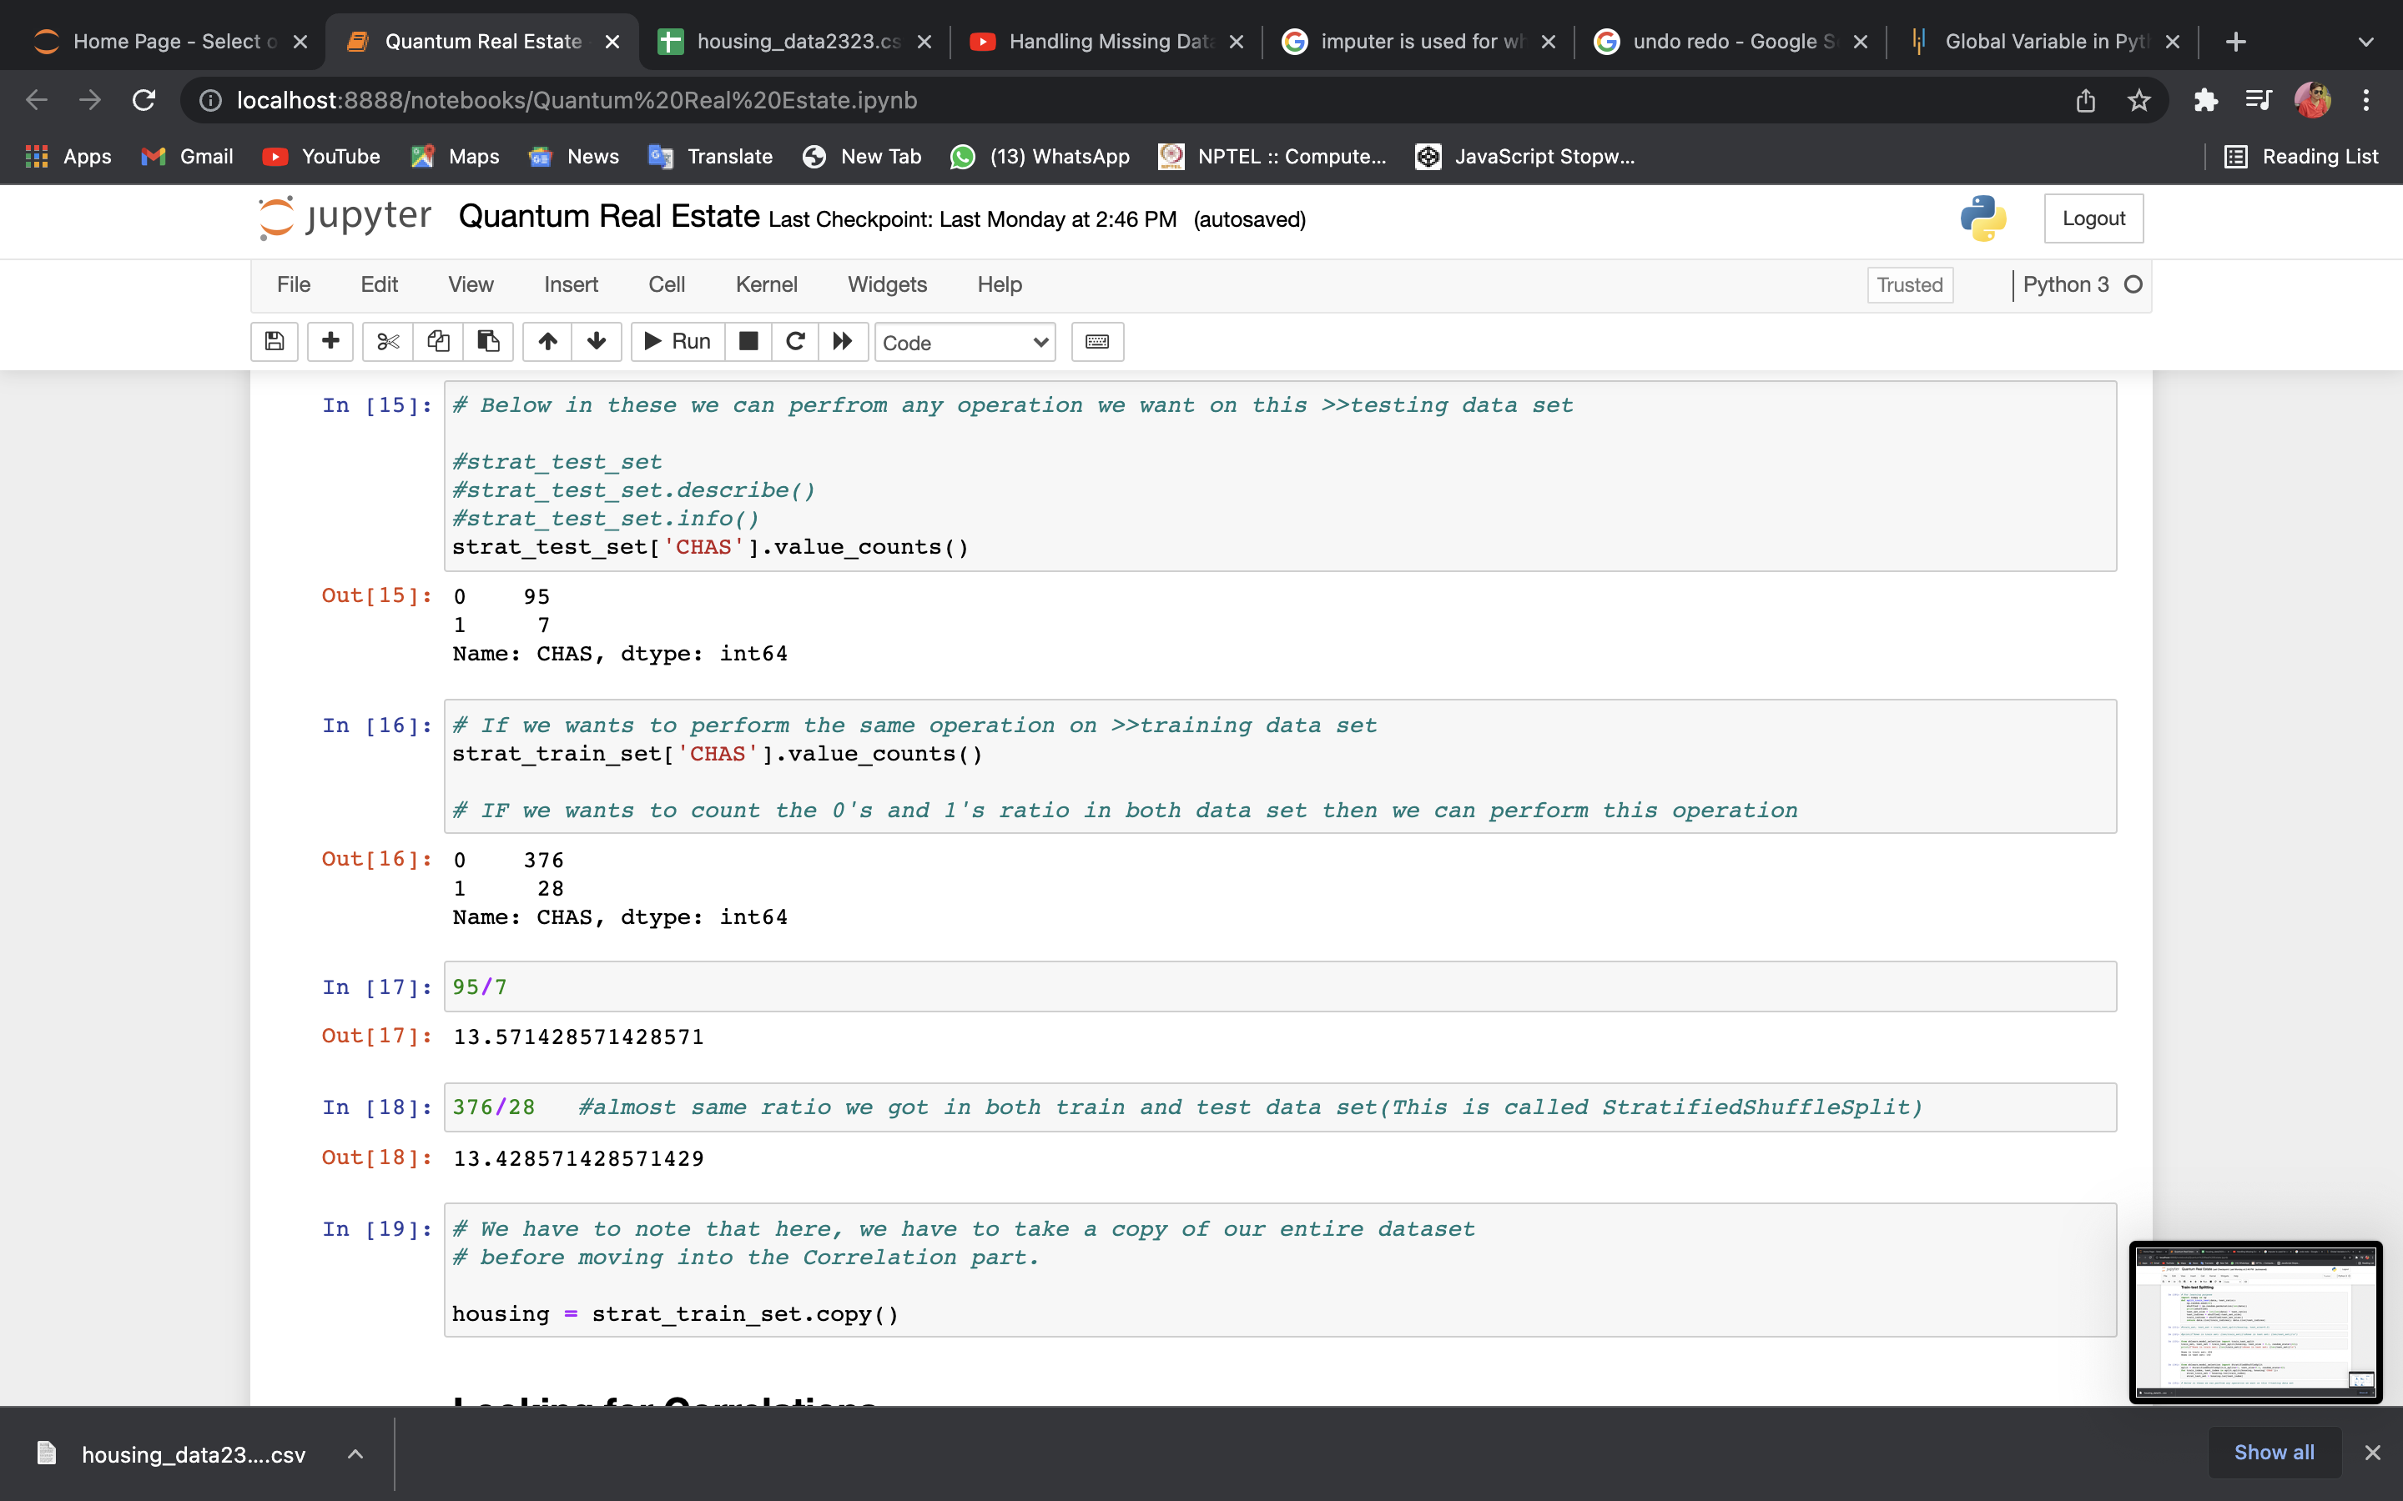

Slide 15
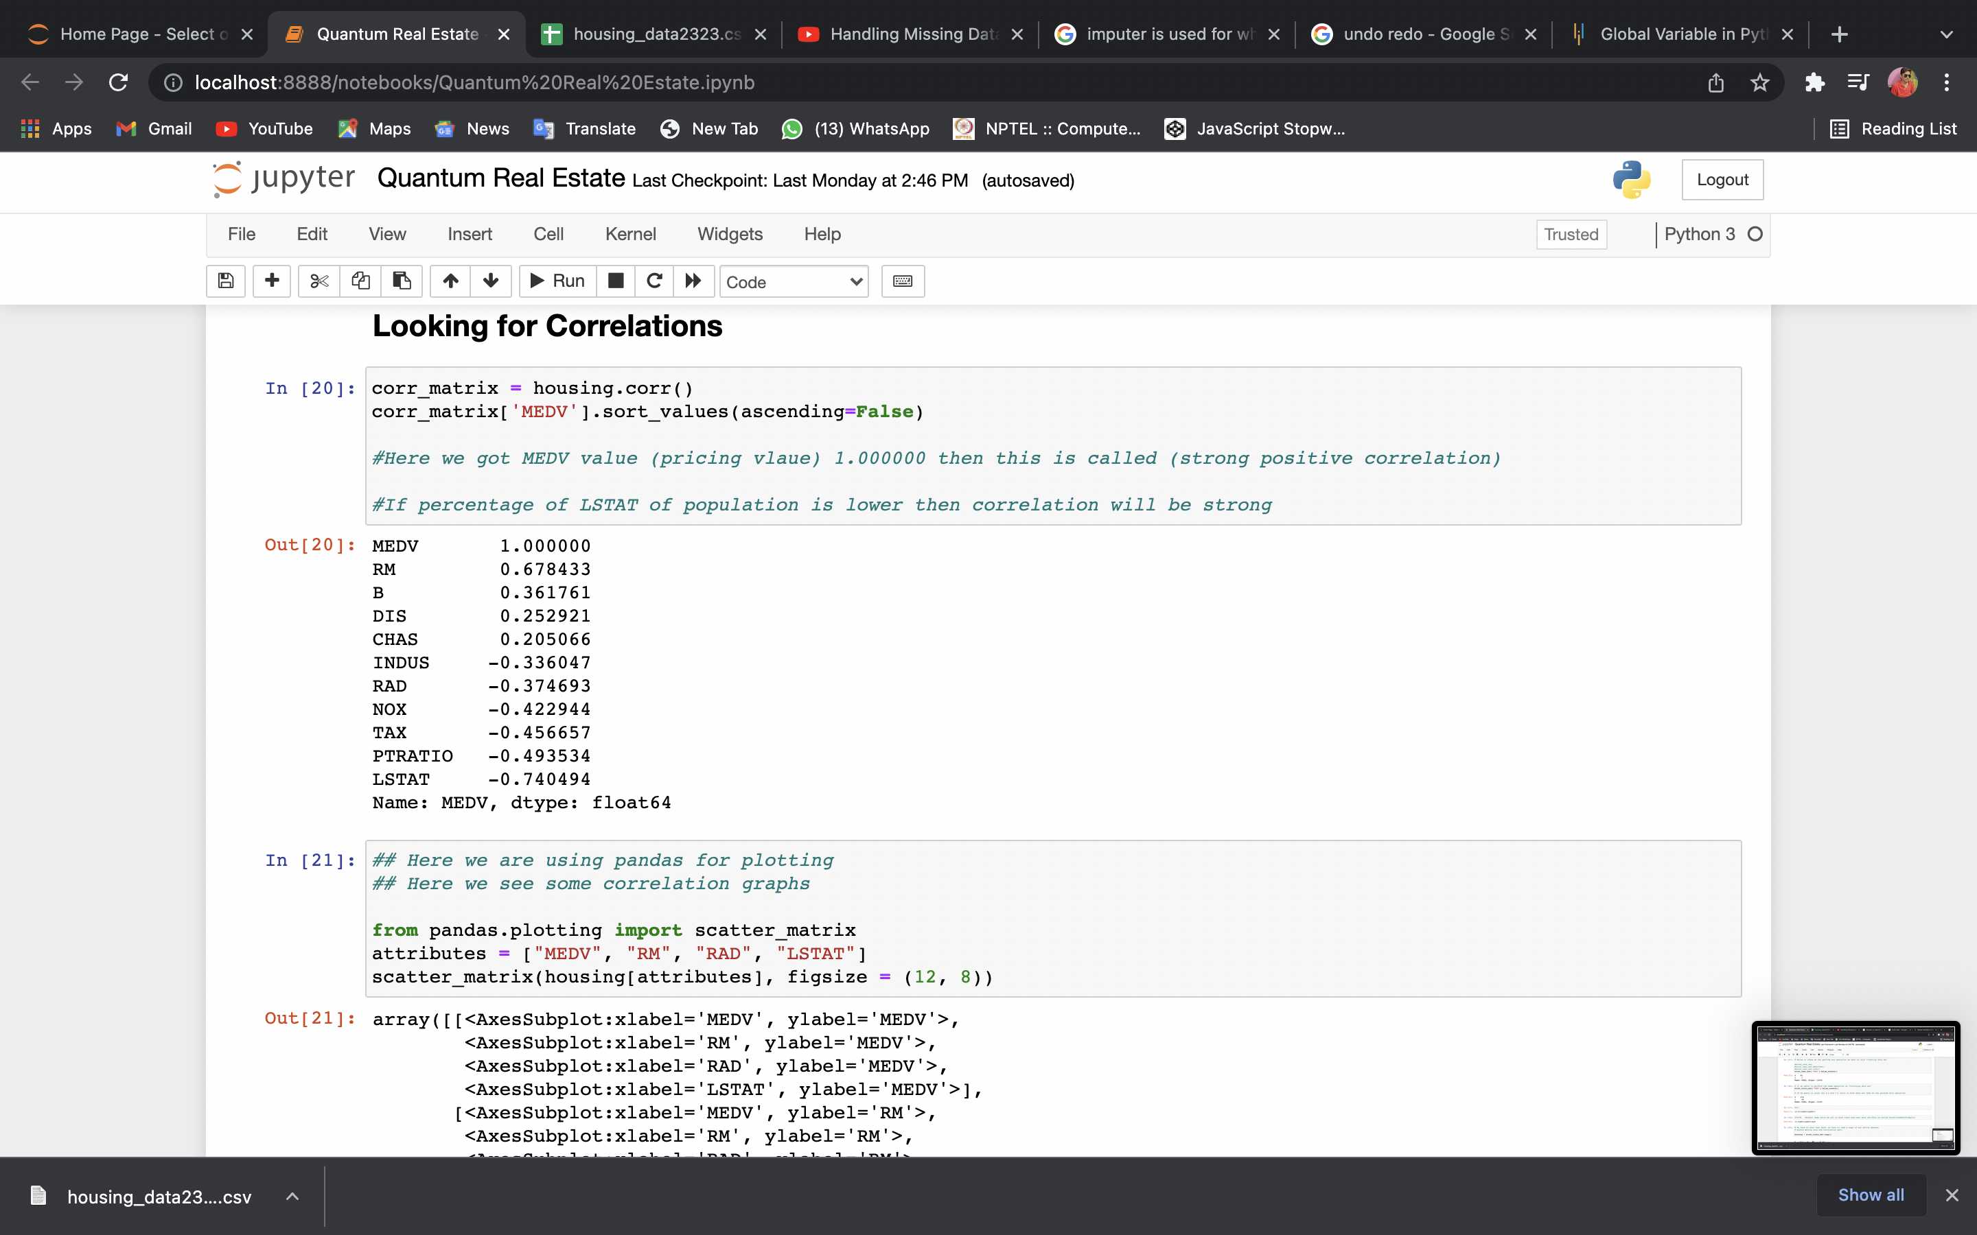

Slide 16
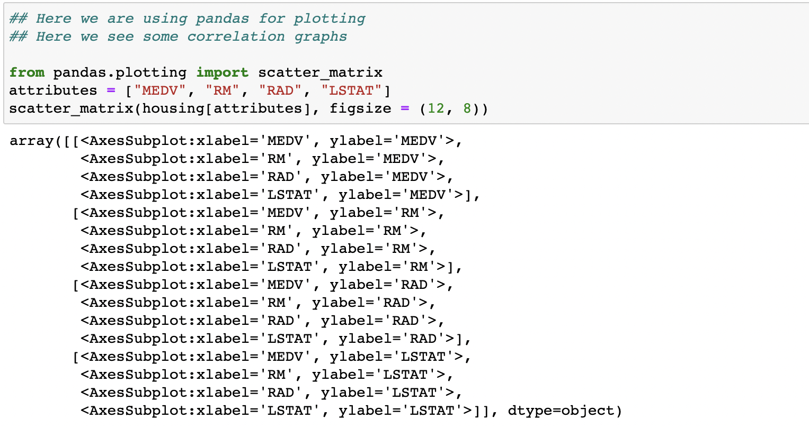
here we can correlate between housing price and the number of bedrooms.We can clearly see here that when we increase the number of bedrooms then the pricing of the houses will automatically increased.

Slide 17
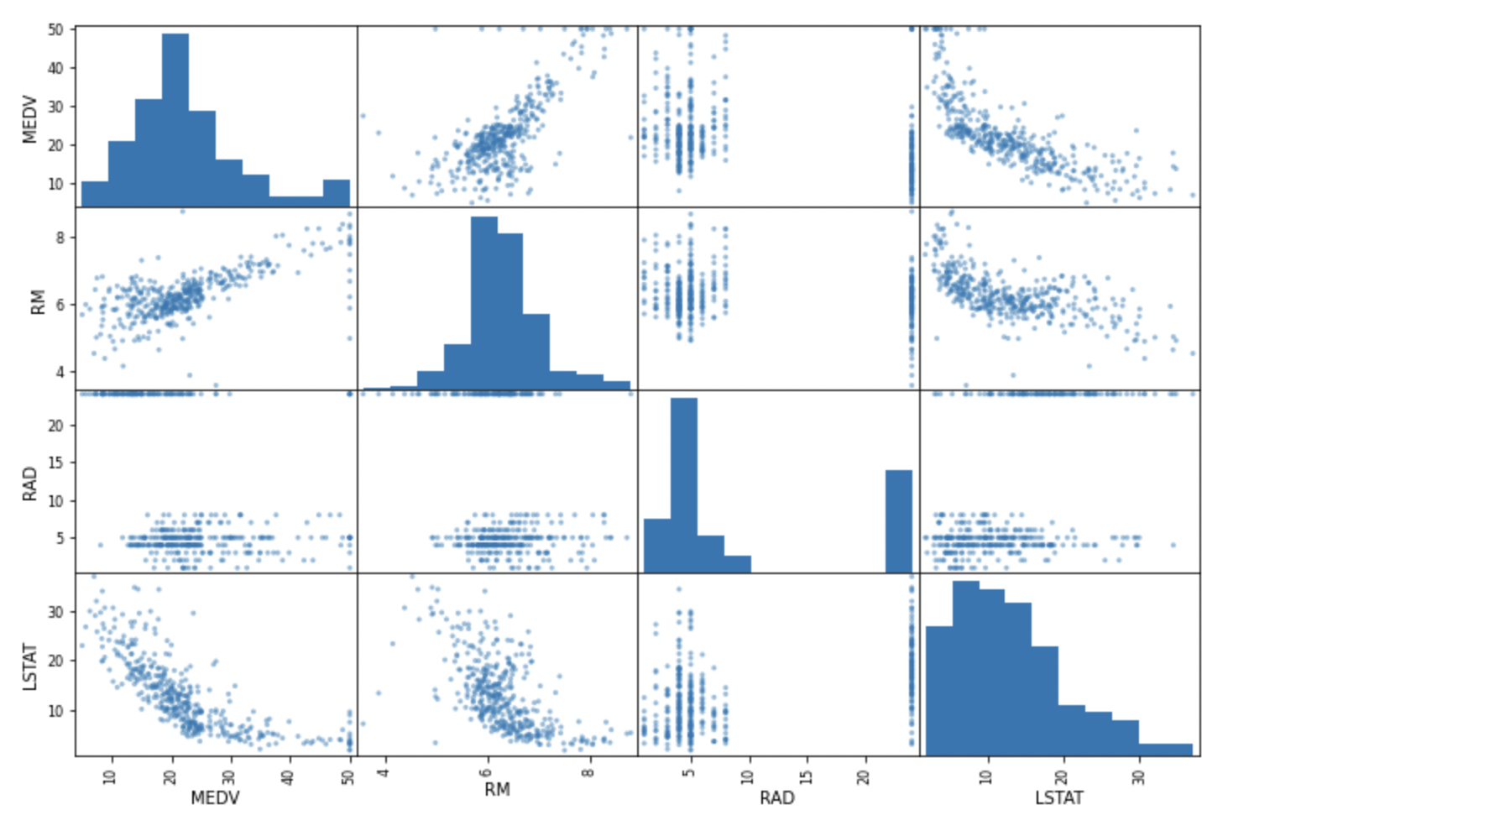
here we have done correlation between both two attributes. first is the pricing of house and second one is number of rooms provided on a single graph. Where the number of rooms denoted by variable x and housing price denoted by variable y.

Slide 18
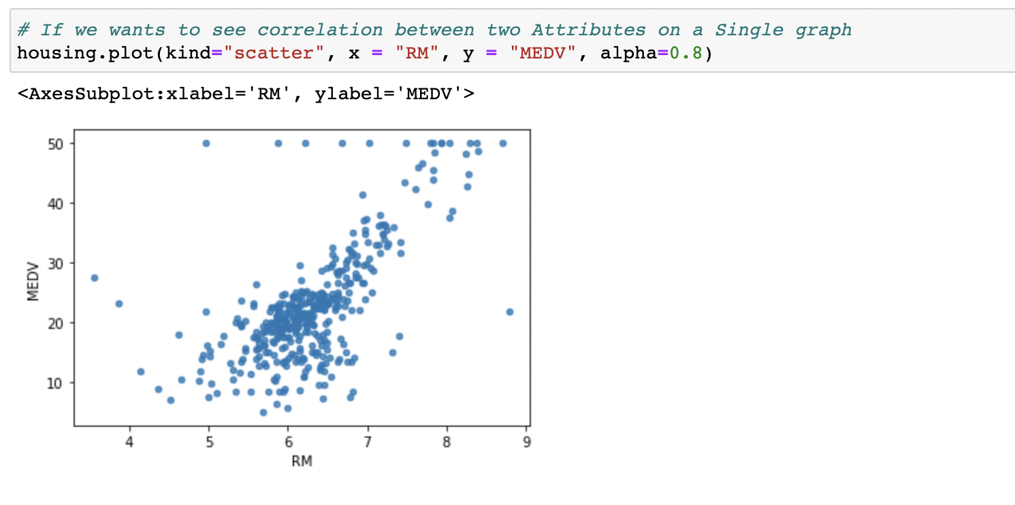
>>>here we have perform correlation operation or attribute combination operation on the tax will be taken on the house price and the other one is number of rooms. And we have created a ner variable “TAXRM” and assign into housing price. we have predicted the tax only basis of what number of rooms available in that house.

Slide 19
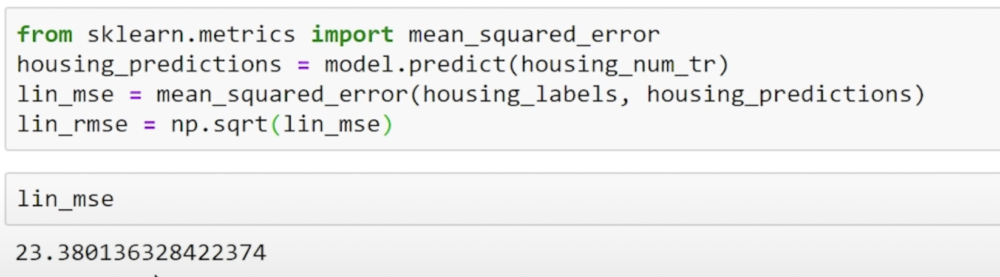
>>>And we have got an prediction array in result
>>>And we have printed the value of labels
Evaluating the model
#Here we have imported mean_squared_error from sklearn to get Square root of that Linear Regression model
Here Cross validation wants Utility, Utility is greater is better that's why we are us ing negtive_mean_error we have used here to maximize the Utility.

Slide 20
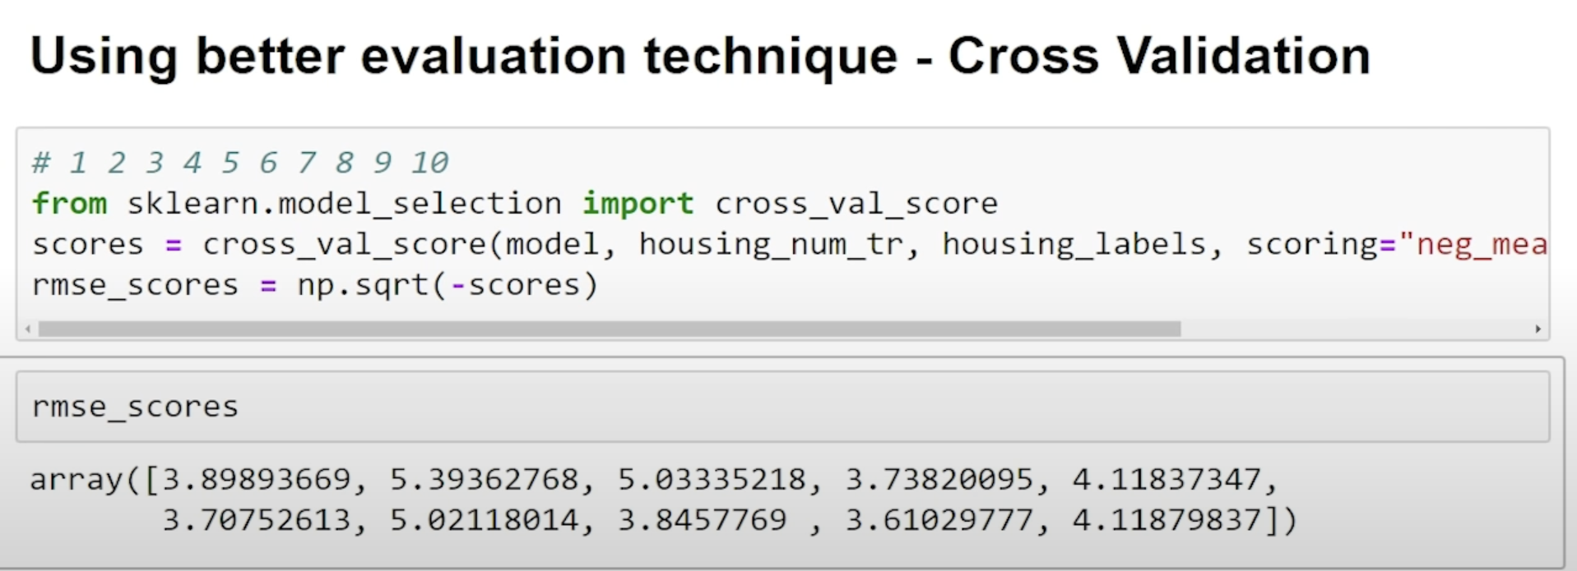
Finally we got The Array Of Predicted Scores and the Mean of that data, and Standard Deviation of that data.

Slide 21
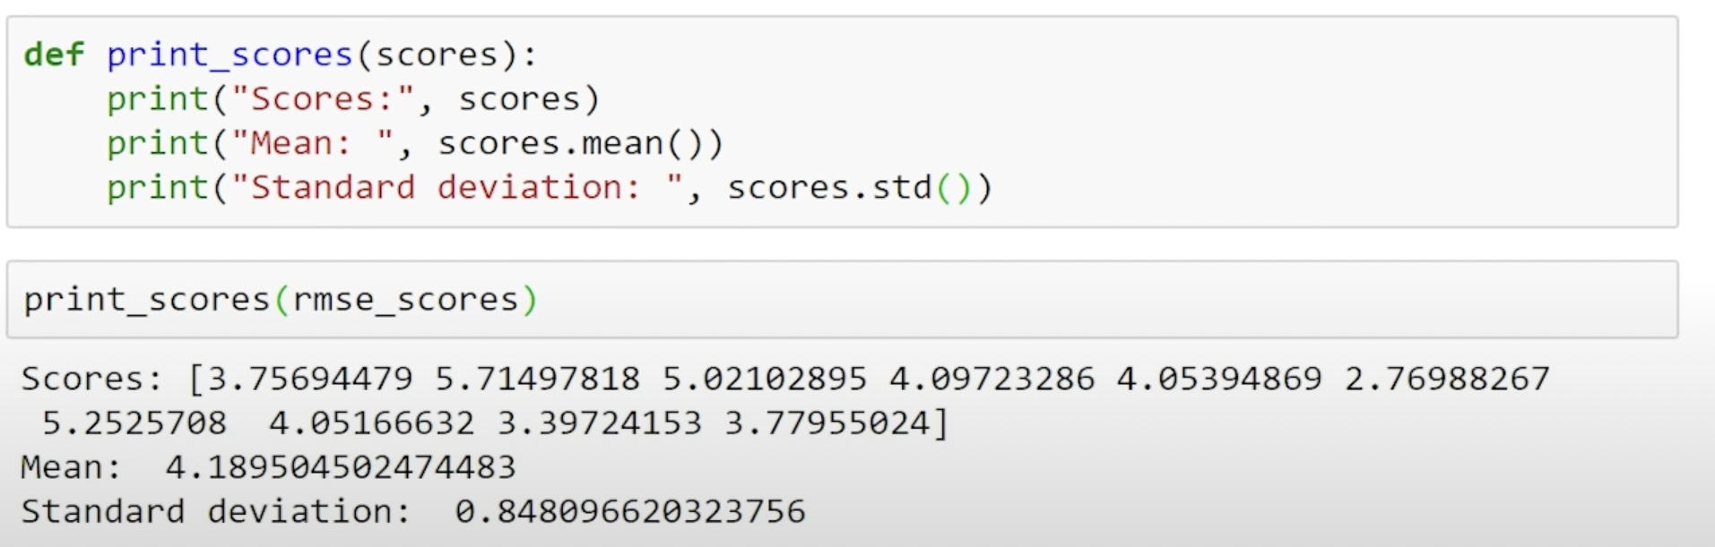
Finally we got The Array Of Predicted Scores and the Mean of that data, and Standard Deviation of that data.

Slide 22
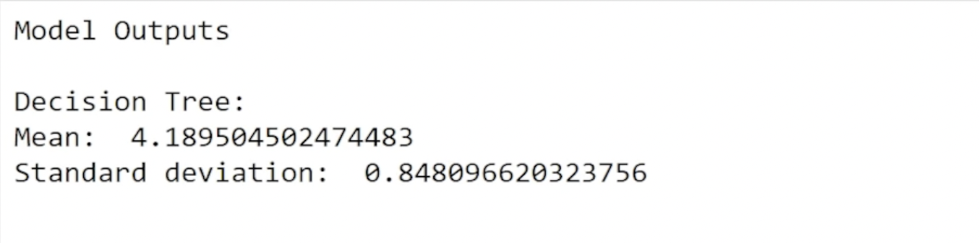
This is the final output of our Decision Tree model that we have got to predict the approximate value of houses
This is the final output we got from our Linear Regression model that we have imported from sklearn to get desired output or desired prediction for out Real Estate data set.

Slide 23
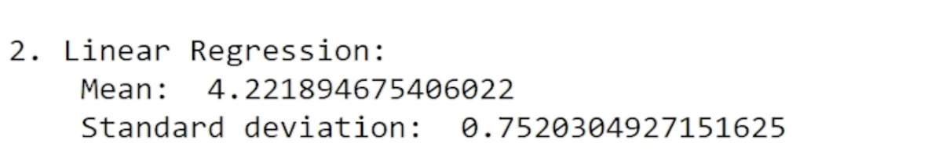
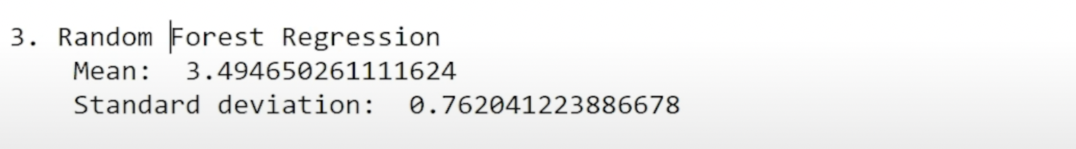
Regression Model Output :-
Finally we have the Result of our Random Forest Model Regressor() that we have used to predict the housing price, we seen that this model performs far better than the Linear Regression and Decision tree model that we have imported to get the result, we can say that Random Forest Model Approach would be the best one Approach to get the desired model Prediction.

Slide 24
Conclusion
Machine Learning can be a Supervised or Unsupervised. If you have lesser amount of data and clearly labelled data for training, opt for Supervised Learning. Unsupervised Learning would generally give better performance and results for large data sets. If you have a huge data set easily available, go for deep learning techniques. You also have learned Reinforcement Learning and Deep Reinforcement Learning. You now know what Neural Networks are, their applications and limitations.

Slide 25
THANK YOU!

